Slide 1
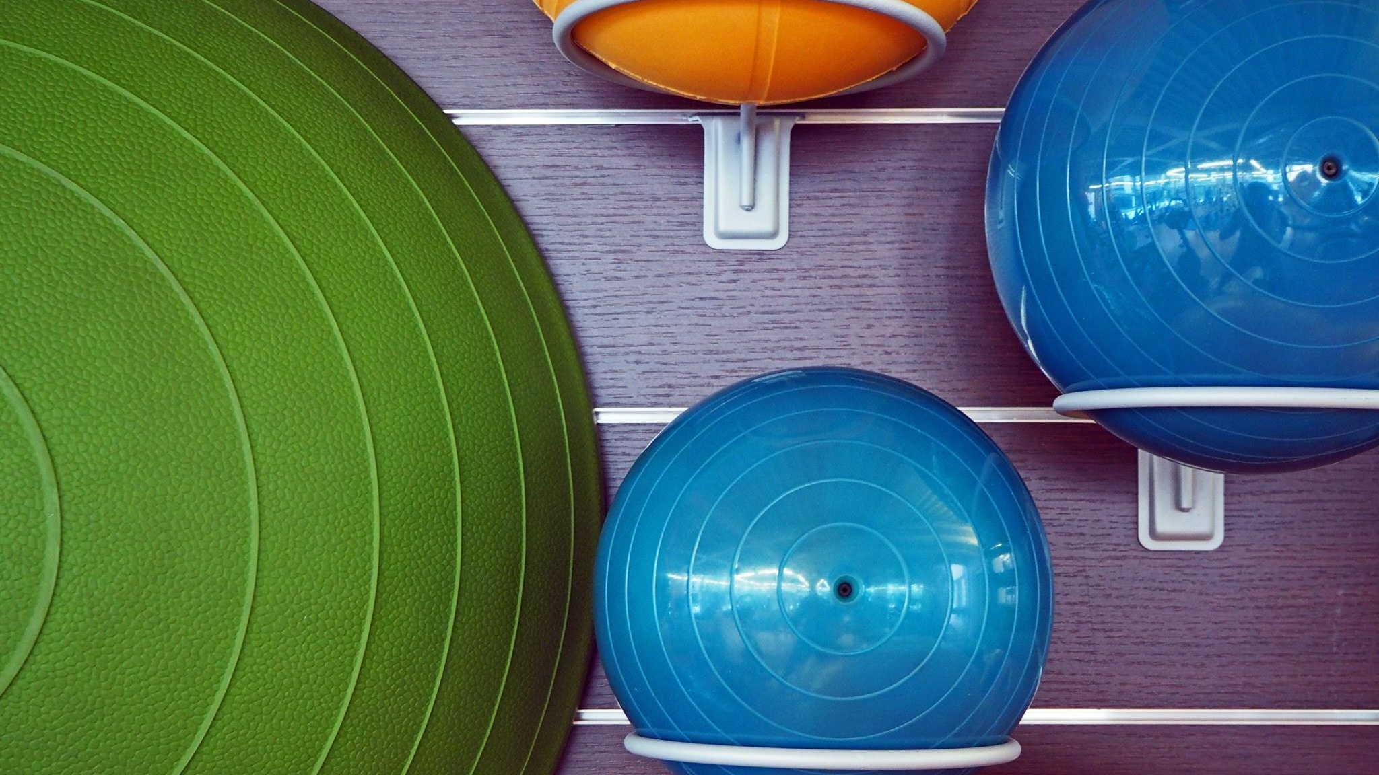
Pool Simulator
Dovydas Simkus - 2235289
Bogdan sergijenko - 2235285
ostin mathias - 2015862
chris kerr - 2328018

Slide 2

Overall Design
We had two attempts at creating a pool game:
main(Old).py:
An attempt to create the physics ourselves, this code does have a lot more visible mathematics however it is not working correctly.
MainPoolGame.py:
This version we used pymunk as it has a physics library that allows easy implementation of movement and collisions.

Slide 3
The Pool Balls
The balls cover projectile motion, use of coordinates and shapes, and movement.
Pymunk handles the movement of the balls by using bodies and calculates velocity using the bodies parameters (mass, elasticity, current velocity, and force applied).
Parameters:
Ball radius – size of the balls
Ball mass, elasticity – used in movement calculations
Ball Position – storing where the ball is currently at
Balls – set that contains all ball objects
Ball velocity – calculated by
Functions:
Draw balls – The current location vector and radius is inputted, and it draws the ball at its location accordingly

Slide 4
Collisions
Collisions will cover target hitting, scoring, shapes, and transformations.
Pymunk handles the collision of the balls by using bodies and uses parameters like the bodies mass, elasticity, the positions relative to each other, and each balls velocity.
Parameters:
Ball mass, elasticity – used to calculate collisions
Ball Positions – to compare to other ball locations
Hole Positions – position of the holes to calculate the collisions when comparing to ball positions
Ball Positions – position of the balls to compare to the hole positions
Functions:
Hole Collision – takes in the current ball’s position vector and radius, and if it collides with a hole it return it to the ball_delete set.

Slide 5
Cue
Cue covers the use of coordinates, lines, and shapes as well as movement across the screen.
Functions:
Takes in the cue ball and mouse position vectors as inputs, calculates the the x and y distances and then returns the angle of the cue stick.
update() – takes in an angle as input and assigns it to the cue stick object
draw() – takes in the angle from the cue stick object as input and draws it into pygame
Parameters:
Angle – calculated by comparing mouse and cue ball positions

Slide 6
Table/Score
Table and Scoring will cover the use of shapes and lines alongside a scoring system.
Functions:
Draw Table – takes in the colors, widths, and heights of the rectangles as inputs and draws them to resemble a pool table. It also take in the hole_positions, and its radius to draw them in.
Draw Score – takes the player’s current score as an input and displays it into the window.
Add Points – takes in the player’s current score and points to add as inputs and add the points to the current score
Display Score – Takes the player’s current score as an input and displays it into the console.
Parameters:
Score – player’s current score
Player Name – player entered name
Hole Positions – The set of the positions where all holes are to be drawn

Slide 7
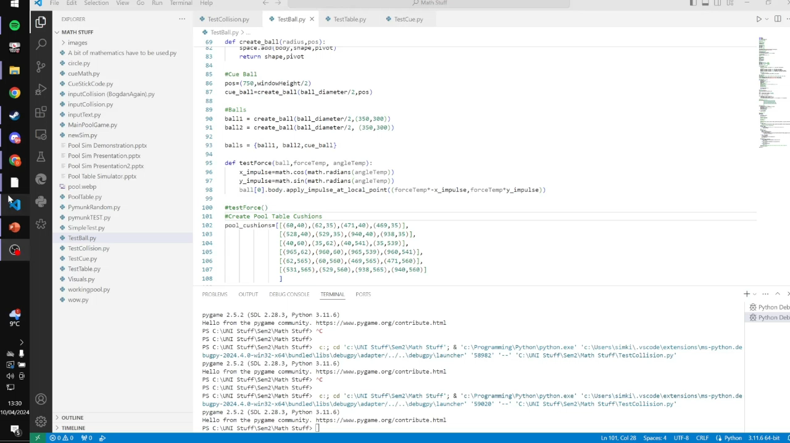
Simulating Balls

Slide 8
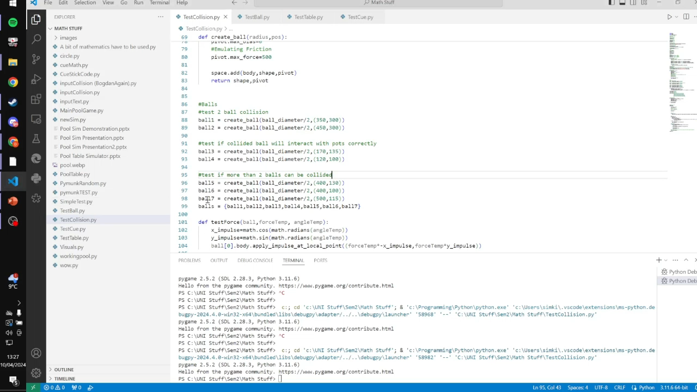
Simulating Collision

Slide 9
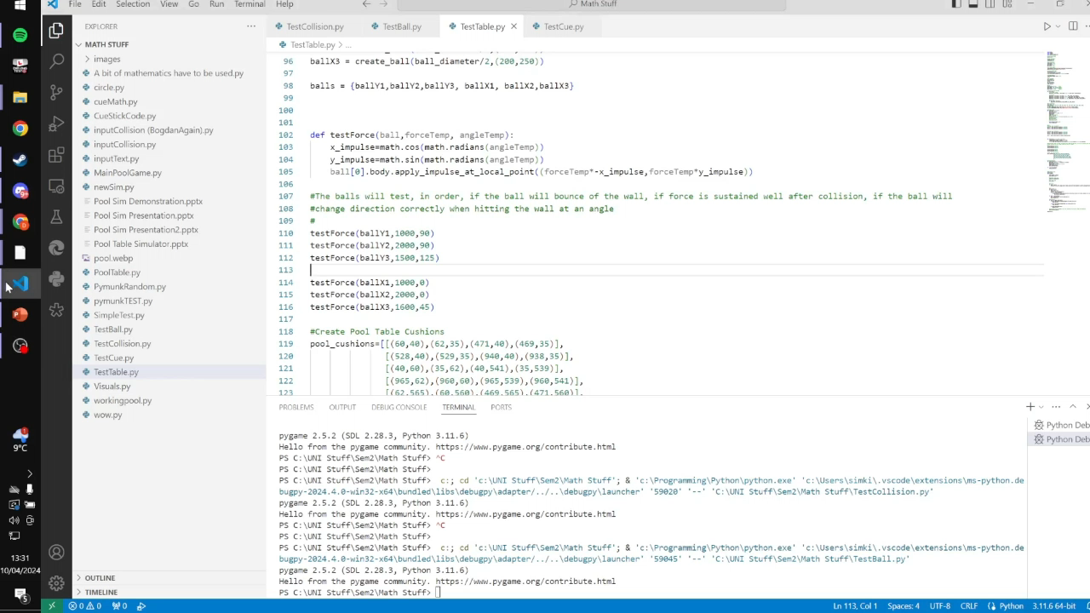
Simulating Table

Slide 10
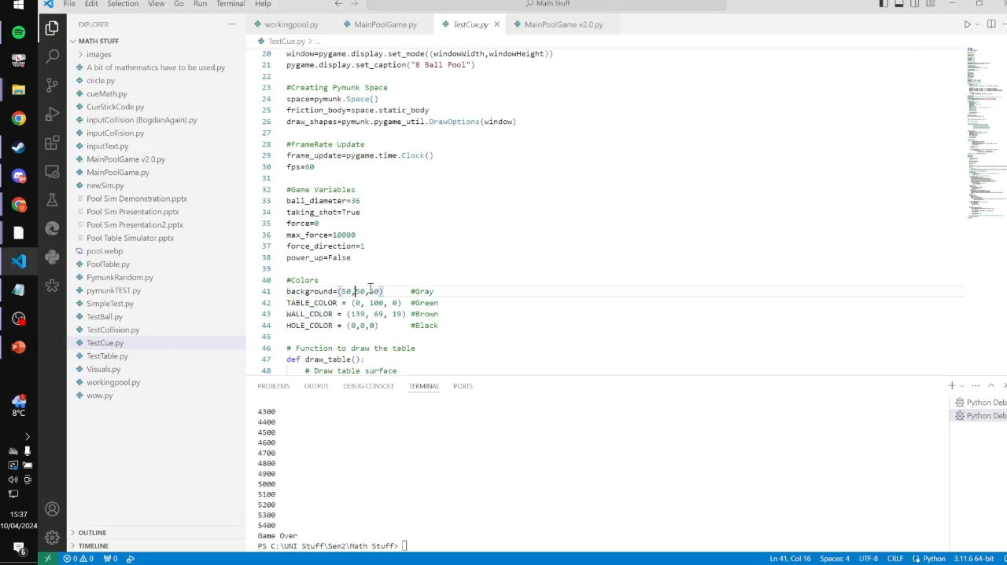
Simulating Cue

